Slide 1
Code-A-Thon 2016 DisplayBTeam
Chris Meyers
William Reeder
Robert Reeder
Ryne Wolfgang

Slide 2
ArTech Search and Rescue
Mission Statement:
Our goal was to create a planning and decision aid application for search rescue. This application is based on the NASA Worldwind SDK.

Slide 3
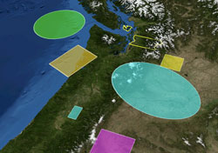
What is Worldwind?
World Wind is a free, open source API developed by NASA that provides a virtual globe. It allows developers to quickly and easily create interactive visualizations of 3D globe, map and geographical information.
Organizations across the world use World Wind to monitor weather patterns, visualize cities and terrain, track the movement of planes, vehicles and ships, analyze geospatial data, and educate people about the Earth.

